Slide 1
Prefix Sum And Difference Array

Slide 2
Week 1 Review
Know how to sort an array/list/vector in the language you are using
Python -> .sort()
Java -> Collections.sort() or Arrays.sort()
C++ -> sort(first_iterator, last_iterator)

Slide 3
Description
A prefix sum array is used to get the sum of a range in O(1) time
However, it takes O(n) time to preprocess everything
A prefix sum array works by holding the value of the sum of numbers from the beginning all the way to the specified index
Eg. pre[i] = sum of all elements from 1 to i
To get the sum of all numbers within a range (l to r), simply subtract the sum of all numbers from 1 to l-1 with the sum of all numbers from 1 to r
Sum of #s from l to r = pre[r] - pre[l-1];
To preprocess the prefix sum array, loop from 1 to n and continuously add the value of the previous prefix sum and the element at the current index
for (int i = 1; i <= array.length; i++) {
pre[i] = pre[i-1] + array[i];
}

Slide 4
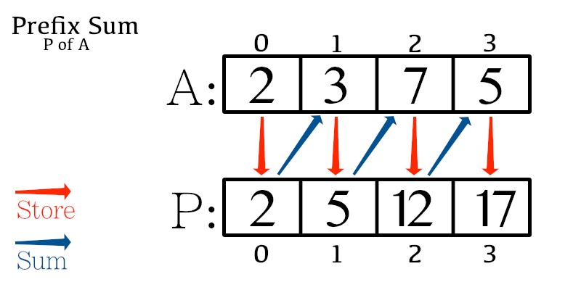

Slide 5
Code
int n //The quantity of numbers in the array
int[] nums //Assume first num is at index 1
int[] psa //Stores the prefix sum array
for(int i = 1; i<=n; i++){
//psa[i] stores sum of numbers from 1 .. i
//This means psa[i] stores sum of numbers from 1 .. i-1 + nums[i]
//This is equivalent to psa[i-1] + nums[i]
psa[i] = psa[i-1] + nums[i]
}

Slide 6
Question
https://dmoj.ca/problem/dmopc14c2p4

Slide 7
Difference Array
A difference array allows us to do range increments/decrements by marking the positions in O(1) and performing a “prefix sum” through the array afterwards O(n)
Static updates
To increment a range [L, R] by value x
Increment A[L] by x
Decrement A[R+1] by x
After finishing the markings, do a sweep through the array
Loop through the array using i: A[1], A[2], A[3] . . . A[N], A[i] = A[i]+A[i-1]

Slide 8
Code
//Create an array A
int [] A
//Increment range [1, 3] by 5
A[1] += 5;
A[3+1] -= 5;
//Construct the real array from the edits
for(int i = 1; i <= n; i++) A[i] += A[i-1];

Slide 9
Problems
https://dmoj.ca/problem/dmopc17c4p1

